Slide 1
Introduction to Box Model

Slide 2
Agenda
Introduction to Box Model
Sample output
Position of Box Model
Box Model implementation

Slide 3
Introduction to Box Model
Box model is the most important tool to keep our web pages well organized.
They help in additional styling of like elements also.
The box can be positioned anywhere on the webpage along with the content in it.
We use div tag for this box model.

Slide 4
Introduction to Box Model
Syntax:
<div>
// all your other tags can be placed here.
</div>
We can style the div tag as needed.
Example:
<div>
<p>ABCDEFGHIJ……</p>
</div>

Slide 5
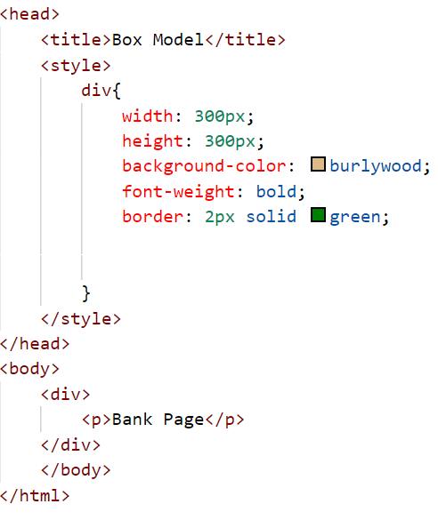
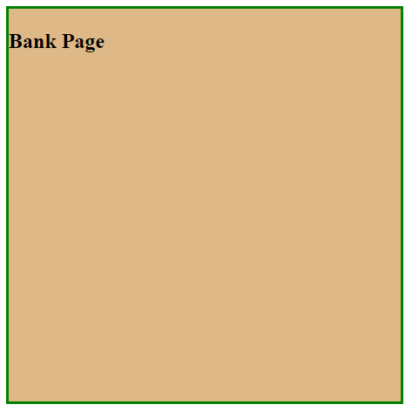
Sample output

Slide 6
Position of Box Model
We have various positioning of box model. We have,
Position: static
Position: relative
Position: absolute
Position: fixed
Position: sticky
We will see the implementation of these in this video.

Slide 7
Summary
Div tag is used to group all the tags in a box and will help you to manage them as needed.
DO NOT WRITE ANYTHING
HERE. LEAVE THIS SPACE FOR
WEBCAM

Slide 8
Thank You
Proprietary content. ©Great Learning. All Rights Reserved. Unauthorized use or distribution prohibited

